Slide 1
Topic 2: Mechanics 2.1 – Motion
Essential idea: Motion may be described and analysed by the use of graphs and equations.
Nature of science: Observations: The ideas of motion are fundamental to many areas of physics, providing a link to the consideration of forces and their implication. The kinematic equations for uniform acceleration were developed through careful observations of the natural world.
Notes:
© 2006 By Timothy K. Lund

Slide 2
Topic 2: Mechanics 2.1 – Motion
Understandings:
• Distance and displacement
• Speed and velocity
• Acceleration
• Graphs describing motion
• Equations of motion for uniform acceleration
• Projectile motion
• Fluid resistance and terminal speed
Notes:
‹#›
© 2006 By Timothy K. Lund

Slide 3
Topic 2: Mechanics 2.1 – Motion
Applications and skills:
• Determining instantaneous and average values for velocity, speed and acceleration
• Solving problems using equations of motion for uniform acceleration
• Sketching and interpreting motion graphs
• Determining the acceleration of free-fall experimentally
• Analysing projectile motion, including the resolution of vertical and horizontal components of acceleration, velocity and displacement
• Qualitatively describing the effect of fluid resistance on falling objects or projectiles, including reaching terminal speed
Notes:
‹#›
© 2006 By Timothy K. Lund

Slide 4
Topic 2: Mechanics 2.1 – Motion
Guidance:
• Calculations will be restricted to those neglecting air resistance
• Projectile motion will only involve problems using a constant value of g close to the surface of the Earth
• The equation of the path of a projectile will not be required
Data booklet reference:
• v = u + at
• s = ut + (1/2)at²
• v² = u² + 2as
• s = (1/2)(v + u) / t
Notes:
‹#›
© 2006 By Timothy K. Lund

Slide 5
Topic 2: Mechanics 2.1 – Motion
International-mindedness:
• International cooperation is needed for tracking shipping, land-based transport, aircraft and objects in space
Theory of knowledge:
• The independence of horizontal and vertical motion in projectile motion seems to be counter-intuitive. How do scientists work around their intuitions? How do scientists make use of their intuitions?
Notes:
‹#›
© 2006 By Timothy K. Lund

Slide 6
Topic 2: Mechanics 2.1 – Motion
Utilization:
• Diving, parachuting and similar activities where fluid resistance affects motion
• The accurate use of ballistics requires careful analysis
• Biomechanics (see Sports, exercise and health science SL sub-topic 4.3)
• Quadratic functions (see Mathematics HL sub-topic 2.6; Mathematics SL sub-topic 2.4; Mathematical studies SL sub-topic 6.3)
• The kinematic equations are treated in calculus form in Mathematics HL sub-topic 6.6 and Mathematics SL sub-topic 6.6
Notes:
‹#›
© 2006 By Timothy K. Lund

Slide 7
Topic 2: Mechanics 2.1 – Motion
Aims:
• Aim 2: much of the development of classical physics has been built on the advances in kinematics
• Aim 6: experiments, including use of data logging, could include (but are not limited to): determination of g, estimating speed using travel timetables, analysing projectile motion, and investigating motion through a fluid
• Aim 7: technology has allowed for more accurate and precise measurements of motion, including video analysis of real-life projectiles and modelling/simulations of terminal velocity
Notes:
‹#›
© 2006 By Timothy K. Lund

Slide 8


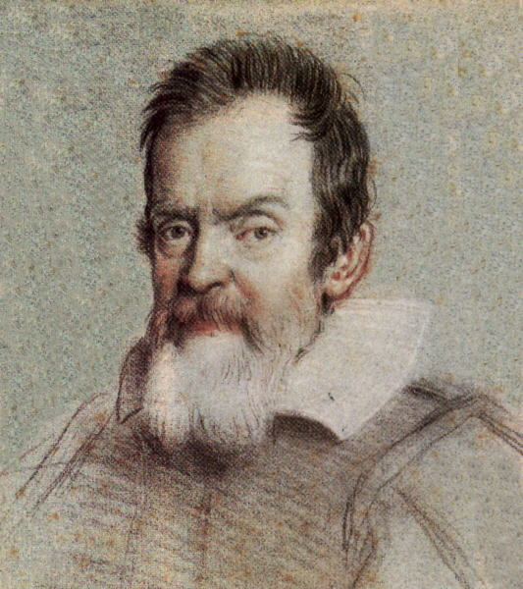

Topic 2: Mechanics 2.1 – Motion
Distance and displacement
∙Mechanics is the branch of physics which concerns itself with forces, and how they affect a body's motion.
∙Kinematics is the sub-branch of mechanics which studies only a body's motion without regard to causes.
∙Dynamics is the sub-branch of mechanics which studies the forces which cause a body's motion.
The two pillars of mechanics
Galileo
Newton
Kinematics
Dynamics
(Calculus)
Notes:
© 2006 By Timothy K. Lund

Slide 9

Topic 2: Mechanics 2.1 – Motion
Distance and displacement
∙Kinematics is the study of displacement, velocity and acceleration, or in short, a study of motion.
∙A study of motion begins with position and change in position.
∙Consider Freddie the Fly, and his quest for food:
∙The distance Freddie travels is simply how far he has flown, without regard to direction. Freddie's distance is 6 meters.
Melted chocolate chip
d = 6 m
Notes:
© 2006 By Timothy K. Lund

Slide 10
Topic 2: Mechanics 2.1 – Motion
Distance and displacement
∙Distance is simply how far something has traveled without regard to direction. Freddy has gone 6 m.
∙Displacement, on the other hand, is not only distance traveled, but also direction.
∙This makes displacement a vector. It has a magnitude (6 m) and a direction (+ x-direction).
∙We say Freddie travels through a displacement of 6 m in the positive x-direction.
Distance = 6 m
Displacement = 6 m in the positive x-direction
Notes:
© 2006 By Timothy K. Lund

Slide 11
Topic 2: Mechanics 2.1 – Motion
Distance and displacement
∙Let’s revisit some previous examples of a ball moving through some displacements…
∙Displacement A is just 15 m to the right (or +15 m for short).
∙Displacement B is just 20 m to the left (or -20 m for short).
Displacement A
x(m)
Displacement B
x(m)
Vector
FYI
∙Distance A is 15 m, and Distance B is 20 m. There is no regard for direction in distance.
Scalar
Notes:
© 2006 By Timothy K. Lund

Slide 12
Topic 2: Mechanics 2.1 – Motion
Distance and displacement
∙Now for some detailed analysis of these two motions…
∙Displacement ∆x (or s) has the following formulas:
Displacement A
x(m)
Displacement B
x(m)
∆x = x₂ – x₁
displacement
s = x₂ – x₁
where x₂ is the final position
and x₁ is the initial position
FYI
∙Many textbooks use ∆x for displacement, and IB uses s. Don’t confuse the “change in ∆” with the “uncertainty ∆” symbol. And don’t confuse s with seconds!
Notes:
© 2006 By Timothy K. Lund

Slide 13
Topic 2: Mechanics 2.1 – Motion
Distance and displacement
∆x = x₂ – x₁
displacement
s = x₂ – x₁
where x₂ is the final position
and x₁ is the initial position
EXAMPLE: Use the displacement formula to find each displacement. Note that the x = 0 coordinate has been placed on the number lines.
SOLUTION:
For A: s = (+10) – (-5) = +15 m.
For B: s = (-10) – (+10) = -20 m.
1
2
Displacement A
x(m)
2
0
1
Displacement B
x(m)
FYI
∙The correct direction (sign) is automatic!
Notes:
© 2006 By Timothy K. Lund

Slide 14
Topic 2: Mechanics 2.1 – Motion
Speed and velocity
∙Velocity v is a measure of how fast an object moves through a displacement.
∙Thus, velocity is displacement divided by time, and is measured in meters per second (m s⁻¹).
v = ∆x / ∆t
velocity
v = s / t
EXAMPLE: Find the velocity of the second ball (Ball B) if it takes 4 seconds to complete its displacement.
SOLUTION:
For B: s = (-10) – (+10) = -20 m.
But t = 4 s. Therefore v = -20 m / 4 s = -5 m s⁻¹.
Note that v “inherits” its direction from s.
Notes:
© 2006 By Timothy K. Lund

Slide 15
Topic 2: Mechanics 2.1 – Motion
Speed and velocity
∙From the previous example we calculated the velocity of the ball to be -5 m s⁻¹.
∙Thus, the ball is moving 5 m s⁻¹ to the left.
∙With disregard to the direction, we can say that the ball’s speed is 5 m s⁻¹.
∙We define speed as distance divided by time, with disregard to direction.
PRACTICE: A runner travels 64.5 meters in the negative x-direction in 31.75 seconds. Find her velocity, and her speed.
SOLUTION: ∙Her velocity is -64.5 / 31.75 = - 2.03 m s⁻¹.
∙Her speed is 64.5 / 31.75 = 2.03 m s⁻¹.
Notes:
© 2006 By Timothy K. Lund

Slide 16
Topic 2: Mechanics 2.1 – Motion
Acceleration
∙Acceleration is the change in velocity over time.
∙Since u and v are measured in m/s and since t is measured in s, a is measured in m/s², or in IB format, a is measured in m s⁻².
a = ∆v / ∆t
acceleration
a = (v – u) / t
where v is the final velocity
and u is the initial velocity
FYI
∙Many textbooks use ∆v = v_{f} - v_{i} for change in velocity, v_{f} for final velocity and v_{i} initial velocity. IB gets away from the subscripting mess by choosing v for final velocity and u for initial velocity.
Notes:
© 2006 By Timothy K. Lund

Slide 17

Topic 2: Mechanics 2.1 – Motion
Acceleration
a = ∆v / ∆t
acceleration
a = (v – u) / t
where v is the final velocity
and u is the initial velocity
EXAMPLE: A driver sees his speed is 5.0 m s⁻¹. He then simultaneously accelerates and starts a stopwatch. At the end of 10. s he observes his speed to be 35 m s⁻¹. What is his acceleration?
SOLUTION: Label each number with a letter:
∙v = 35 m s⁻¹, u = 5.0 m s⁻¹, and t = 10. s.
Next, choose the formula: a = (v – u) / t.
Now substitute and calculate:
a = ( 35 – 5 ) / 10 = 3.0 m s⁻².
Notes:
© 2006 By Timothy K. Lund

Slide 18
Topic 2: Mechanics 2.1 – Motion
Acceleration
a = ∆v / ∆t
acceleration
a = (v – u) / t
where v is the final velocity
and u is the initial velocity
PRACTICE:
Why is velocity a vector?
Why is acceleration a vector?
SOLUTION:
Velocity is a displacement over time. Since displacement is a vector, so is velocity.
Acceleration is a change in velocity over time. Since velocity is a vector, so is acceleration.
Notes:
© 2006 By Timothy K. Lund

Slide 19

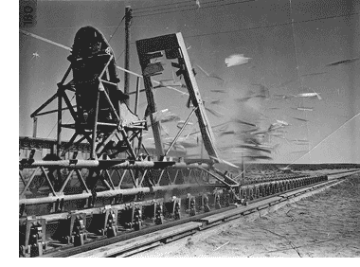
Topic 2: Mechanics 2.1 – Motion
Solving problems using equations of motion for uniform acceleration
∙Back in the 1950s, military aeronautical engineers thought that humans could not withstand much of an acceleration, and therefore put little effort into pilot safety belts and ejection seats.
∙An Air Force physician by the name of Colonel Stapp, however, thought humans could withstand higher accelerations.
∙He designed a rocket sled to accelerate at up to 40g (at which acceleration you would feel like you weighed 40 times your normal weight!).
Notes:
© 2006 By Timothy K. Lund

Slide 20
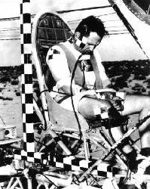
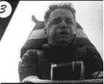
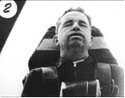
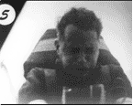
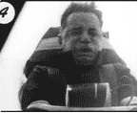
Topic 2: Mechanics 2.1 – Motion
Solving problems using equations of motion for uniform acceleration
∙The human to be tested would be Stapp himself.
∙An accelerometer and a video camera were attached to the sled. Here are the results:
Notes:
© 2006 By Timothy K. Lund

Slide 21

Topic 2: Mechanics 2.1 – Motion
Solving problems using equations of motion for uniform acceleration
∙Here are the data.
∙In 1954, America's original Rocketman, Col. John Paul Stapp, attained a then-world record land speed of 632 mph, going from a standstill to a speed faster than a .45 bullet in 5.0 seconds on a specially-designed rocket sled, and then screeched to a dead stop in 1.4 seconds, sustaining more than 40g's of force, all in the interest of safety.
∙There are TWO accelerations in this problem:
He speeds up from 0 to 632 mph in 5.0 s.
He slows down from 632 mph to 0 in 1.4 s.
Notes:
© 2006 By Timothy K. Lund

Slide 22
Topic 2: Mechanics 2.1 – Motion
Solving problems using equations of motion for uniform acceleration
∙There are TWO accelerations in this problem:
He speeds up from 0 to 632 mph in 5.0 s.
He slows down from 632 mph to 0 in 1.4 s.
EXAMPLE: Convert 632 mph to m/s.
SOLUTION: ∙Use “well-chosen” ones…
EXAMPLE: Was Stapp more uncomfortable while he was speeding up, or while he was slowing down?
SOLUTION: While slowing down. Why?
632 mi
1 h
×
5280 ft
1 mi
×
1 m
3.28 ft
×
1 h
3600. s
=
280 m
s
Notes:
© 2006 By Timothy K. Lund

Slide 23
Topic 2: Mechanics 2.1 – Motion
Solving problems using equations of motion for uniform acceleration
∙There are TWO accelerations in this problem:
He speeds up from 0 to 632 mph in 5.0 s.
He slows down from 632 mph to 0 in 1.4 s.
EXAMPLE: Find Stapp’s acceleration during the speeding up phase.
SOLUTION:
EXAMPLE: Find Stapp’s acceleration during the slowing down phase.
Δv
Δt
280 m/s - 0 m/s
5 s
v - v
Δt
0 m/s
=
f i
= 60 m/s²
a =
=
a =
v - u
t
=
0 m/s - 280 m/s
1.4 s
= ⁻ 200 m s⁻²
Notes:
© 2006 By Timothy K. Lund

Slide 24



Topic 2: Mechanics 2.1 – Motion
Determining instantaneous and average values for velocity, speed and acceleration
∙Consider a car whose position is changing.
∙A patrol officer is checking its speed with a radar gun as shown.
∙The radar gun measures the position of the car during each successive snapshot, shown in yellow.
∙How can you tell that the car is speeding up?
∙What are you assuming about the radar gun time?
Notes:
© 2006 By Timothy K. Lund

Slide 25
Topic 2: Mechanics 2.1 – Motion
Determining instantaneous and average values for velocity, speed and acceleration
∙We can label each position with an x and the time interval between each x with a ∆t.
∙Then v_{A} = (x₂ - x₁)/∆t, v_{B} = (x₃ - x₂)/∆t, and finally v_{C} = (x₄ - x₃)/∆t.
∙Focus on the interval from x₂ to x₃.
∙Note that the speed changed from x₂ to x₃, and so v_{B} is NOT really the speed for that whole interval.
∙We say the v_{B} is an average speed (as are v_{A} and v_{C}).
v_{A}
v_{B}
v_{C}
∆t
∆t
∆t
x₁
x₂
x₃
x₄
Notes:
© 2006 By Timothy K. Lund

Slide 26
Topic 2: Mechanics 2.1 – Motion
Determining instantaneous and average values for velocity, speed and acceleration
∙If we increase the sample rate of the radar gun (make the ∆t smaller) the positions will get closer together.
∙Thus the velocity calculation is more exact.
∙We call the limit as ∆t approaches zero in the equation v = ∆x / ∆t the instantaneous velocity.
∙For this level of physics we will just be content with the average velocity. Limits are beyond the scope of this course. You can use the Wiki extensions to explore limits, and derivatives, if interested.
Notes:
© 2006 By Timothy K. Lund

Slide 27
Topic 2: Mechanics 2.1 – Motion
Determining instantaneous and average values for velocity, speed and acceleration
∙By the same reasoning, if ∆t gets smaller in the acceleration equation, our acceleration calculation becomes more precise.
∙We call the limit as ∆t approaches zero of the equation a = ∆v / ∆t the instantaneous acceleration.
∙For this level of physics we will be content with the average acceleration. See the Wiki for extensions if you are interested!
Notes:
© 2006 By Timothy K. Lund

Slide 28
Topic 2: Mechanics 2.1 – Motion
Equations of motion for uniform acceleration
∙The equations for uniformly accelerated motion are also known as the kinematic equations. They are listed here
s = ut + (1/2)at ²
v = u + at
v² = u² + 2as
s = (u + v)t / 2
∙They can only be used if the acceleration a is CONSTANT (uniform).
∙They are used so commonly throughout the physics course that we will name them.
Displacement
Velocity
Timeless
Average displacement
Notes:
© 2006 By Timothy K. Lund

Slide 29
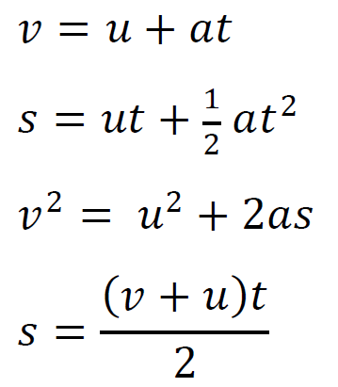
Topic 2: Mechanics 2.1 – Motion
Equations of motion for uniform acceleration
∙The equations for uniformly accelerated motion are also known as the kinematic equations. They are listed here
s = ut + (1/2)at ²
v = u + at
v² = u² + 2as
s = (u + v)t / 2
∙They can only be used if the acceleration a is CONSTANT (uniform).
∙They are used so commonly throughout the physics course that we will name them.
Notes:
© 2006 By Timothy K. Lund

Slide 30
Topic 2: Mechanics 2.1 – Motion
Equations of motion for uniform acceleration
∙From a = (v – u)/t we get
at = v – u.
∙Rearrangement leads to v = u + at, the velocity equation.
∙Now, if it is the case that the acceleration is constant, then the average velocity can be found by taking the sum of the initial and final velocities and dividing by 2 (just like test grades). Thus
average velocity = (u + v) / 2.
∙But the displacement is the average velocity times the time, so that s = (u + v)t / 2, the average displacement equation.
Notes:
© 2006 By Timothy K. Lund

Slide 31
Topic 2: Mechanics 2.1 – Motion
Equations of motion for uniform acceleration
∙We have derived v = u + at and s = (u + v)t / 2.
∙Let’s tackle the first of the two harder ones.
s = (u + v)t / 2
s = (u + u + at)t / 2
s = (2u + at)t / 2
s = 2ut/2 + at ²/ 2
s = ut + (1/2)at ²
∙which is the displacement equation.
∙Since the equation s = (u + v)t/2 only works if the acceleration is constant, s = ut + (1/2)at ² also works only if the acceleration is constant.
Given
v = u + at
Like terms
Distribute t/2
Cancel 2
Notes:
© 2006 By Timothy K. Lund

Slide 32
Topic 2: Mechanics 2.1 – Motion
Equations of motion for uniform acceleration
∙We now have derived v = u + at, s = (u + v)t / 2 and s = ut + (1/2)at ². Let’s tackle the timeless equation.
∙From v = u + at we can isolate the t.
v – u = at
t = (v – u)/a
∙From s = (u + v)t / 2 we get:
2s = (u + v)t
2s = (u + v)(v – u) / a
2as = (u + v)(v – u)
2as = uv – u² + v² – vu
v² = u² + 2as
Multiply by 2
t = (v - u)/a
Multiply by a
F O I L
Cancel (uv = vu)
Notes:
© 2006 By Timothy K. Lund

Slide 33
Topic 2: Mechanics 2.1 – Motion
Equations of motion for uniform acceleration
∙Just in case you haven’t written these down, here they are again.
∙We will practice using these equations soon. They are extremely important.
∙Before we do, though, we want to talk about freefall and its special acceleration g.
s = ut + (1/2)at²
Displacement
kinematic equations
v = u + at
Velocity
v² = u² + 2as
Timeless
a is constant
s = (u + v)t/2
Average displacement
Notes:
© 2006 By Timothy K. Lund

Slide 34
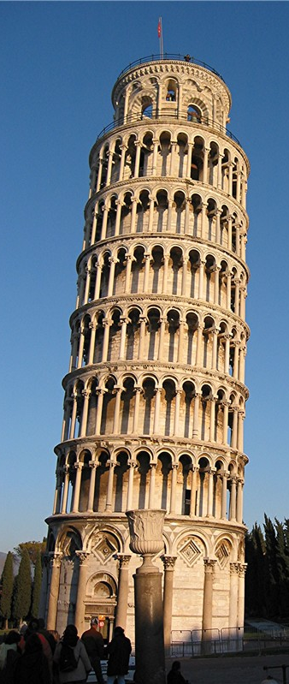
Topic 2: Mechanics 2.1 – Motion
Determining the acceleration of free-fall experimentally
∙Everyone knows that when you drop an object, it picks up speed when it falls.
∙Galileo did his famous freefall experiments on the tower of Pisa long ago, and determined that all objects fall at the same acceleration in the absence of air resistance.
∙Thus, as the next slide will show, an apple and a feather will fall side by side!
Notes:
© 2006 By Timothy K. Lund

Slide 35
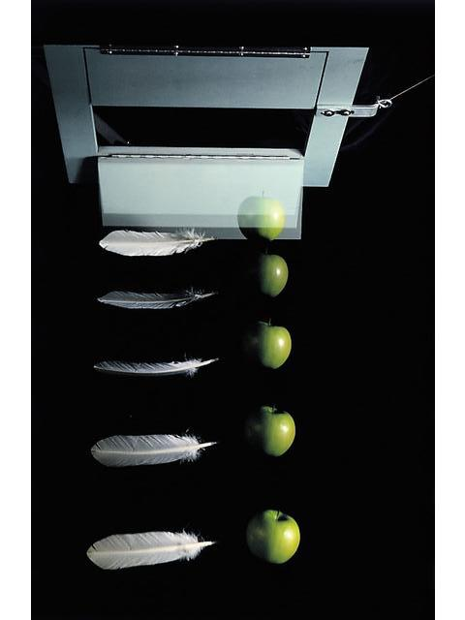
Topic 2: Mechanics 2.1 – Motion
Determining the acceleration of free-fall experimentally
∙Consider the multiflash image of an apple and a feather falling in a partial vacuum:
∙If we choose a convenient spot on the apple, and mark its position, we get a series of marks like so:
Notes:
© 2006 By Timothy K. Lund

Slide 36
Topic 2: Mechanics 2.1 – Motion
Determining the acceleration of free-fall experimentally
∙Now we SCALE our data. Given that the apple is 8 cm in horizontal diameter we can superimpose this scale on our photograph.
∙Then we can estimate the position in cm of each image.
0 cm
-9 cm
-22 cm
-37 cm
-55 cm
Notes:
© 2006 By Timothy K. Lund

Slide 37
Topic 2: Mechanics 2.1 – Motion
Determining the acceleration of free-fall experimentally
∙Suppose we know that the time between images is 0.056 s.
∙We make a table starting with the raw data columns of t and y.
∙We then make calculations columns in Δt, Δy and v.
0 cm
-9 cm
-22 cm
t(s)
y(cm)
Δt
Δy
v
t(s)
y(cm)
Δt
Δy
v
.000
0
.000
0
.056
-9
.056
-37 cm
-161
.056
-9
.056
-9
-161
-9
FYI: To find Δt you need to subtract TWO t's. Therefore the first entry for Δt is BLANK.
FYI: To find v you need to divide Δy by Δt. By convention, CURRENT Δy DIVIDED BY CURRENT Δt.
.112
-22
.056
-13
-232
FYI: To find Δy you need to subtract TWO y's. By convention, CURRENT y MINUS PREVIOUS y.
.112
-22
.056
-13
-232
FYI: To find Δt you need to subtract TWO t's. By convention, CURRENT t MINUS PREVIOUS t.
.168
-37
.056
-15
-268
.168
-37
.056
-15
-268
FYI: Same thing for the first Δy.
.224
-55
.056
-18
-321
.224
-55
.056
-18
-321
-55 cm
FYI: Since v = Δy / Δt, the first v entry is also BLANK.
Notes:
© 2006 By Timothy K. Lund

Slide 38
Topic 2: Mechanics 2.1 – Motion
Determining the acceleration of free-fall experimentally
∙Now we plot v vs. t on a graph.
t(s)
y(cm)
Δt
Δy
v
.000
0
.056
-9
.056
-9
-161
.112
-22
.056
-13
-232
.168
-37
.056
-15
-268
v
.224
-55
.056
-18
-321
TIME / sec
.000
.056
.112
.168
.224
0
t
-50
-100
VELOCITY / cm sec⁻¹
-150
-200
-250
-300
Notes:
© 2006 By Timothy K. Lund

Slide 39
Topic 2: Mechanics 2.1 – Motion
Determining the acceleration of free-fall experimentally
FYI
∙The graph v vs. t is linear. Thus a is constant.
∙The y-intercept (the initial velocity of the apple) is not zero. But this just means we don’t have all of the images of the apple.
v
TIME (sec)
.000
.056
.112
.168
.224
0
t / s
-50
-100
VELOCITY (cm/sec)
-150
-200
-250
-300
Notes:
‹#›
© 2006 By Timothy K. Lund

Slide 40
Topic 2: Mechanics 2.1 – Motion
Determining the acceleration of free-fall experimentally
FYI
∙Finally, the acceleration is the slope of the v vs. t graph:
a =
Δv
Δt
=
-220 cm/s
0.224 s
= -982 cm/s²
v
TIME (sec)
.000
.056
.112
.168
.224
0
t / s
-50
Δt = 0.224 s
-100
VELOCITY (cm/sec)
-150
-200
Δv = -220 cm/s
-250
-300
Notes:
‹#›
© 2006 By Timothy K. Lund

Slide 41
Topic 2: Mechanics 2.1 – Motion
Determining the acceleration of free-fall experimentally
∙Since this acceleration due to gravity is so important we give it the name g.
∙ALL objects accelerate at -g , where
g = 980 cm s⁻²
in the absence of air resistance.
∙We can list the values for g in three ways:
∙Hammer and feather drop Apollo 15
g = 980 cm s⁻²
We usually round the metric value to 10:
magnitude of the freefall acceleration
g = 9.80 m s⁻²
g = 32 ft s⁻²
g = 10. m s⁻²
Notes:
© 2006 By Timothy K. Lund

Slide 42
Topic 2: Mechanics 2.1 – Motion
Solving problems using equations of motion for uniform acceleration
-General:
s = ut + (1/2)at², and
v = u + at, and
v² = u² + 2as, and
s = (u + v)t / 2;
-Freefall: Substitute ‘-g’ for ‘a’ in all of the above equations.
FYI
∙The kinematic equations will be used throughout the year. We must master them NOW!
Notes:
© 2006 By Timothy K. Lund

Slide 43


1
2
s = ut + at ²
v = u + at
v² = u² + 2as
Notes:
© 2006 By Timothy K. Lund

Slide 44
Topic 2: Mechanics 2.1 – Motion
Solving problems using equations of motion for uniform acceleration
EXAMPLE: How far will Pinky and the Brain go in 30.0 seconds if their acceleration is 20.0 m s⁻²?
KNOWN
FORMULAS
a = 20 m/s²
Given
1
2
s = ut + at²
t = 30 s
Given
v = u + at
u = 0 m/s
Implicit
v² = u² + 2as
s = ?
SOLUTION
WANTED
∙t is known - drop the timeless eq’n.
1
2
s = ut + at²
1
2
s = 0(30) + 20(30)²
∙Since v is not wanted, drop the velocity eq'n:
s = 9000 m
Notes:
© 2006 By Timothy K. Lund

Slide 45
Topic 2: Mechanics 2.1 – Motion
Solving problems using equations of motion for uniform acceleration
EXAMPLE: How fast will Pinky and the Brain be going at this instant?
KNOWN
FORMULAS
1
2
a = 20 m/s²
Given
s = ut + at²
t = 30 s
Given
v = u + at
u = 0 m/s
Implicit
v² = u² + 2as
v = ?
SOLUTION
WANTED
∙t is known - drop the timeless eq’n.
v = u + at
v = 0 + 20(30)
∙Since v is wanted, drop the displacement eq'n:
v = 600 m s⁻¹
Notes:
© 2006 By Timothy K. Lund

Slide 46
Topic 2: Mechanics 2.1 – Motion
Solving problems using equations of motion for uniform acceleration
EXAMPLE: How fast will Pinky and the Brain be going when they have traveled a total of 18000 m?
KNOWN
FORMULAS
1
2
a = 20 m/s²
Given
s = ut + at²
s = 18000 m
v = u + at
Given
u = 0 m/s
Implicit
v² = u² + 2as
v = ?
SOLUTION
WANTED
∙Since t is not known - drop the two eq’ns which have time in them.
v² = u² + 2as
v² = 0² + 2(20)(18000)
v = 850 m s⁻¹
Notes:
© 2006 By Timothy K. Lund

Slide 47
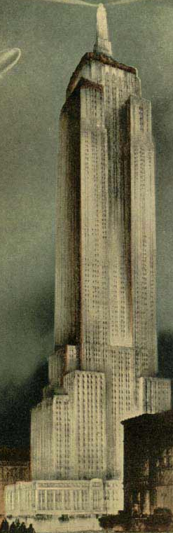
Topic 2: Mechanics 2.1 – Motion
Solving problems using equations of motion for uniform acceleration
EXAMPLE: A ball is dropped off of the Empire State Building (381 m tall). How fast is it going when it hits ground?
KNOWN
FORMULAS
1
2
a = -10 m/s²
Implicit
s = ut + at²
Given
v = u + at
s = -381 m
u = 0 m/s
Implicit
v² = u² + 2as
v = ?
SOLUTION
WANTED
∙Since t is not known - drop the two eq’ns which have time in them.
v² = u² + 2as
v² = 0²+ 2(-10)(-381)
v = -87 m s⁻¹
Notes:
© 2006 By Timothy K. Lund

Slide 48
Topic 2: Mechanics 2.1 – Motion
Solving problems using equations of motion for uniform acceleration
EXAMPLE: A ball is dropped off of the Empire State Building (381 m tall). How long does it take to reach the ground?
KNOWN
FORMULAS
1
2
a = -10 m/s²
Implicit
s = ut + at²
s = -381 m
v = u + at
Given
u = 0 m/s
Implicit
v² = u² + 2as
t = ?
SOLUTION
WANTED
∙Since t is desired and we have s drop the last two eq’ns.
1
2
s = ut + at²
1
2
-381 = 0t + (-10)t²
t = 8.7 s
Notes:
© 2006 By Timothy K. Lund

Slide 49
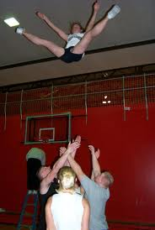
Topic 2: Mechanics 2.1 – Motion
Solving problems using equations of motion for uniform acceleration
EXAMPLE: A cheer leader is thrown up with an initial speed of 7 m s⁻¹. How high does she go?
KNOWN
FORMULAS
1
2
a = -10 m/s²
Implicit
s = ut + at²
Given
v = u + at
u = 7 m s⁻¹
v = 0 m/s
Implicit
v² = u² + 2as
s = ?
SOLUTION
WANTED
∙Since t is not known - drop the two eq’ns which have time in them.
v² = u² + 2as
0² = 7² + 2(-10)s
s = 2.45 m
Notes:
© 2006 By Timothy K. Lund

Slide 50
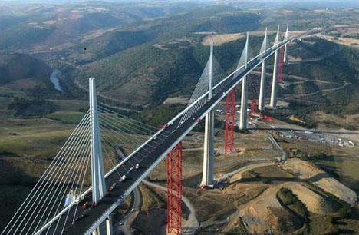
Topic 2: Mechanics 2.1 – Motion
Solving problems using equations of motion for uniform acceleration
EXAMPLE: A ball is thrown upward at 50 m s⁻¹ from the top of the 300-m Millau Viaduct, the highest bridge in the world. How fast is it moving when it hits ground?
KNOWN
FORMULAS
1
2
a = -10 m s⁻²
Implicit
s = ut + at²
u = 50 m s⁻¹
v = u + at
Given
s = -300 m
Implicit
v² = u² + 2as
v = ?
SOLUTION
WANTED
∙Since t is not known - drop the two eq’ns which have time in them.
v² = u² + 2as
v² = 50² + 2(-10)(-300)
v = -90 m s⁻¹
Notes:
© 2006 By Timothy K. Lund

Slide 51
Topic 2: Mechanics 2.1 – Motion
Solving problems using equations of motion for uniform acceleration
EXAMPLE: A ball is thrown upward at 50 m s⁻¹ from the top of the 300-m Millau Viaduct, the highest bridge in the world. How long is it in flight?
KNOWN
FORMULAS
1
2
a = -10 m/s²
Implicit
s = ut + at²
u = 50 m s⁻¹
v = u + at
Given
v = -90 m s⁻¹
Calculated
v² = u² + 2as
t = ?
WANTED
SOLUTION
∙Use the simplest t equation.
v = u + at
-90 = 50 + (⁻10)t
t = 14 s
Notes:
© 2006 By Timothy K. Lund

Slide 52
Topic 2: Mechanics 2.1 – Motion
Sketching and interpreting motion graphs
∙The slope of a displacement-time graph is the velocity.
∙The slope of the velocity-time graph is the acceleration. We already did this example with the falling feather/apple presentation.
∙You will have ample opportunity to find the slopes of distance-time, displacement-time and velocity-time graphs in your labs.
Notes:
© 2006 By Timothy K. Lund

Slide 53
Topic 2: Mechanics 2.1 – Motion
Sketching and interpreting motion graphs
EXAMPLE: Suppose Freddie the Fly begins at x = 0 m, and travels at a constant velocity for 6 seconds as shown. Find two points, sketch a displacement vs. time graph, and then find and interpret the slope and the area of your graph.
SOLUTION:
∙The two points are (0 s, 0 m) and (6 s, 18 m).
∙The sketch is on the next slide.
t = 0,
x = 0
x/m
t = 6 s,
x = 18
Notes:
© 2006 By Timothy K. Lund

Slide 54
Topic 2: Mechanics 2.1 – Motion
Sketching and interpreting motion graphs
SOLUTION:
∙The slope is rise over run or 18 m / 6 s = 3 m / 1 s
∙Thus the slope is 3 m s⁻¹, which is interpreted as Freddie’s velocity.
27
24
21
18
x / m
15
Rise
12
s = 18 - 0
9
6
t = 6 - 0
s = 18 m
Run
3
t = 6 s
0
0
1
2
3
4
5
6
7
8
9
t / s
Notes:
© 2006 By Timothy K. Lund

Slide 55
Topic 2: Mechanics 2.1 – Motion
Sketching and interpreting motion graphs
∙The area under a velocity-time graph is the displacement.
∙The area under an acceleration-time graph is the change in velocity.
∙You will have ample opportunity to draw distance-time, displacement-time and velocity-time graphs in your labs.
Notes:
© 2006 By Timothy K. Lund

Slide 56
Topic 2: Mechanics 2.1 – Motion
Sketching and interpreting motion graphs
EXAMPLE: Calculate and interpret the area under the given v vs. t graph. Find and interpret the slope.
SOLUTION:
∙The area of a triangle is A = (1/2)bh.
∙Thus
A = (1/2)(20 s)(30 m/s) = 300 m.
∙This is the displacement of the object in 20 s.
∙The slope is (30 m/s) / 20 s = 1.5 m s⁻².
∙This is the acceleration of the object.
50
40
30
VELOCITY (ms⁻¹ )
20
10
0
10
15
20
t
0
5
TIME (sec)
Notes:
© 2006 By Timothy K. Lund

Slide 57
Topic 2: Mechanics 2.1 – Motion
Qualitatively describing the effect of fluid resistance on falling objects or projectiles, including reaching terminal speed
-Students should know what is meant by terminal speed.
-This is when the drag force exactly balances the weight.
Notes:
© 2006 By Timothy K. Lund

Slide 58

Topic 2: Mechanics 2.1 – Motion
"A female Blue Whale weighing 190 metric tonnes (418,877lb) and measuring 27.6m (90ft 5in) in length suddenly materialized above the Southern Ocean on 20 March 1947."
y
Guinness World Records.
Falkland Islands Philatelic Bureau. 2 March 2002.
At first, v = 0.
Qualitatively describing the effect of fluid resistance on falling objects or projectiles, including reaching terminal speed
∙Suppose a blue whale suddenly materializes high above the ground.
∙The drag force D is proportional to the speed squared.
∙Thus, as the whale picks up speed, the drag force increases.
∙Once the drag force equals the whale’s weight, the whale will stop accelerating.
∙It has reached terminal speed.
W
Then, as v increases, so does D.
y
D
W
v
v reaches a maximum value, called terminal speed. D = W.
D
y
v_{terminal}
W
Notes:
© 2006 By Timothy K. Lund

Slide 59

Topic 2: Mechanics 2.1 – Motion
Determine relative velocity in one and two dimensions
∙Suppose you are a passenger in a car on a perfectly level and straight road, moving at a constant velocity. Your velocity relative to the pavement might be 60 mph.
∙Your velocity relative to the driver of your car is zero. Whereas your velocity relative to an oncoming car might be 120 mph.
∙Your velocity can be measured relative to any reference frame.
A
Notes:
© 2006 By Timothy K. Lund

Slide 60
Topic 2: Mechanics 2.1 – Motion
Determine relative velocity in one and two dimensions
∙Consider two cars, A and B, shown below.
∙Suppose you are in car A which is moving at v_{A} = +20 m s⁻¹ and next to you is car B, moving at v_{B} = +40 m s⁻¹.
∙As far as you are concerned your velocity relative to car B (v_{AB}) is -20 m s⁻¹ because you seem to be moving backwards relative to B’s coordinate system.
∙We write
v_{AB} = v_{A} - v_{B}
velocity of A relative to B
B
A
Notes:
© 2006 By Timothy K. Lund

Slide 61
Topic 2: Mechanics 2.1 – Motion
B
Determine relative velocity in one and two dimensions
∙The equation works even in two dimensions.
∙Suppose you are in car A which is moving at v_{A} = +40 m s⁻¹ and approaching you at right angles is a car B is moving at v_{B} = -20 m s⁻¹ as shown.
∙Since A and B are moving perpendicular to one another, use a vector diagram to find v_{AB}. The solution is on the next slide.
y
x
A
Notes:
© 2006 By Timothy K. Lund

Slide 62
Topic 2: Mechanics 2.1 – Motion
B
Determine relative velocity in one and two dimensions
∙Draw in the vectors and use v_{AB} = v_{A} - v_{B}.
v_{AB}² = v_{A}² + v_{B}²
v_{AB} = v_{A} - v_{B}
v_{AB}² = 40² + 20²
v_{B}
-v_{B}
v_{AB} = 45 m s⁻¹
v_{A}
A
Notes:
© 2006 By Timothy K. Lund

Slide 63




Topic 2: Mechanics 2.1 – Motion
Projectile motion
∙A projectile is an object that has been given an initial velocity by some sort of short-lived force, and then moves through the air under the influence of gravity.
∙Baseballs, stones, or bullets are all examples of projectiles executing projectile motion.
∙You know that all objects moving through air feel an air resistance (recall sticking your hand out of the window of a moving car).
FYI
∙We will ignore air resistance in the discussion that follows…
Notes:
© 2006 By Timothy K. Lund

Slide 64
Topic 2: Mechanics 2.1 – Motion
Analysing projectile motion
∙Regardless of the air resistance, the vertical and the horizontal components of velocity of an object in projectile motion are independent.
a_{y} = -g
a_{y} = -g
Speeding up in -y dir.
Slowing down in +y dir.
a_{x} = 0
Constant speed in +x dir.
Notes:
© 2006 By Timothy K. Lund

Slide 65
Topic 2: Mechanics 2.1 – Motion
Analysing projectile motion
∙The trajectory of a projectile in the absence of air is parabolic. Know this!
Notes:
© 2006 By Timothy K. Lund

Slide 66
Topic 2: Mechanics 2.1 – Motion
Analysing projectile motion with fluid resistance
∙If there is air resistance, it is proportional to the square of the velocity. Thus, when the ball moves fast its deceleration is greater than when it moves slow.
∙Peak to left of original one.
∙Pre-peak distance more than post-peak.
SKETCH POINTS
Notes:
© 2006 By Timothy K. Lund

Slide 67
Topic 2: Mechanics 2.1 – Motion
Analysing projectile motion
∙Recall the kinematic equations:
∙Since we worked only in 1D at the time, we didn’t have to distinguish between x and y in these equations.
∙Now we appropriately modify the above to meet our new requirements of simultaneous equations:
s = ut + (1/2)at ²
Displacement
kinematic equations 1D
v = u + at
Velocity
a is constant
∆x = u_{x}t + (1/2)a_{x}t ²
kinematic equations 2D
v_{x} = u_{x} + a_{x}t
∆y = u_{y}t + (1/2)a_{y}t ²
a_{x} and a_{y} are constant
v_{y} = u_{y} + a_{y}t
Notes:
© 2006 By Timothy K. Lund

Slide 68
Topic 2: Mechanics 2.1 – Motion
Analysing projectile motion
0
kinematic equations 2D
∆x = u_{x}t + (1/2)a_{x}t ²
0
v_{x} = u_{x} + a_{x}t
∆y = u_{y}t + (1/2)a_{y}t ²
a_{x} and a_{y} are constant
v_{y} = u_{y} + a_{y}t
PRACTICE: Show that the reduced equations for projectile motion are
SOLUTION:
∙a_{x} = 0 in the absence of air resistance.
∙a_{y} = -10 in the absence of air resistance.
∆x = u_{x}t
∆y = u_{y}t - 5t ²
reduced equations of projectile motion
v_{x} = u_{x}
v_{y} = u_{y} - 10t
Notes:
© 2006 By Timothy K. Lund

Slide 69
Topic 2: Mechanics 2.1 – Motion
Analysing projectile motion
∆x = u_{x}t
∆y = u_{y}t - 5t ²
reduced equations of projectile motion
v_{x} = u_{x}
v_{y} = u_{y} - 10t
EXAMPLE: Use the reduced equations above to prove that projectile motion is parabolic in nature.
SOLUTION: Just solve for t in the first equation and substitute it into the second equation.
∆x = u_{x}t becomes t = x / u_{x} so that t ² = x² / u_{x}².
Then since y = u_{y}t - 5t ², we have
y = (u_{y} / u_{x})x – (5 / u_{x}²)x².
FYI
∙The equation of a parabola is y = Ax + Bx².
∙In this case, A = u_{y} / u_{x} and B = -5 / u_{x}².
Notes:
© 2006 By Timothy K. Lund

Slide 70
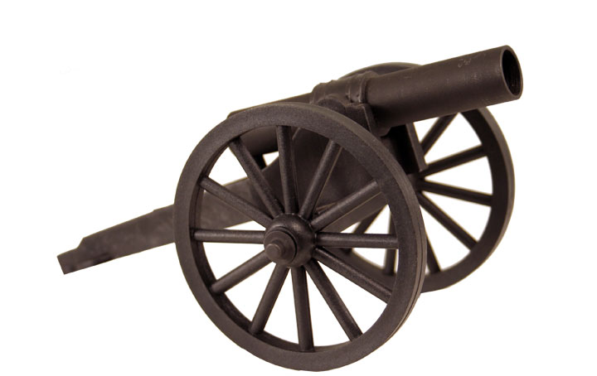
Topic 2: Mechanics 2.1 – Motion
Analysing projectile motion
∆x = u_{x}t
∆y = u_{y}t - 5t ²
reduced equations of projectile motion
v_{x} = u_{x}
v_{y} = u_{y} - 10t
PRACTICE: A cannon fires a projectile with a muzzle velocity of 56 ms⁻¹ at an angle of inclination of 15º.
(a) What are u_{x} and u_{y}?
SOLUTION: Make a velocity triangle.
u = 56 m s⁻¹
u_{y} = u sin θ
θ = 15º
u_{y} = 56 sin 15º
u_{x} = u cos θ
u_{y} = 15 m s⁻¹.
u_{x} = 56 cos 15º
u_{x} = 54 m s⁻¹
Notes:
© 2006 By Timothy K. Lund

Slide 71
Topic 2: Mechanics 2.1 – Motion
Analysing projectile motion
∆x = u_{x}t
∆y = u_{y}t - 5t ²
reduced equations of projectile motion
v_{x} = u_{x}
v_{y} = u_{y} - 10t
PRACTICE: A cannon fires a projectile with a muzzle velocity of 56 ms⁻¹ at an angle of inclination of 15º.
(b) What are the tailored equations of motion?
(c) When will the ball reach its maximum height?
SOLUTION: (b) Just substitute u_{x} = 54 and u_{y} = 15:
(c) At the maximum height, v_{y} = 0. Why? Thus
v_{y} = 15 - 10t becomes 0 = 15 - 10t so that
10t = 15 or t = 1.5 s.
∆x = 54t
∆y = 15t - 5t²
tailored equations for this particular projectile
v_{x} = 54
v_{y} = 15 - 10t
Notes:
© 2006 By Timothy K. Lund

Slide 72
Topic 2: Mechanics 2.1 – Motion
Analysing projectile motion
∆x = 54t
∆y = 15t - 5t ²
tailored equations for this particular projectile
v_{x} = 54
v_{y} = 15 - 10t
PRACTICE: A cannon fires a projectile with a muzzle velocity of 56 ms⁻¹ at an angle of inclination of 15º.
(d) How far from the muzzle will the ball be when it reaches the height of the muzzle at the end of its trajectory?
SOLUTION:
From symmetry t_{up} = t_{down} = 1.5 s so t = 3.0 s.
Thus
∆x = 54t
∆x = 54(3.0)
∆x = 160 m.
Notes:
© 2006 By Timothy K. Lund

Slide 73
Topic 2: Mechanics 2.1 – Motion
Analysing projectile motion
∆x = 54t
∆y = 15t - 5t ²
tailored equations for this particular projectile
v_{x} = 54
v_{y} = 15 - 10t
PRACTICE: A cannon fires a projectile with a muzzle velocity of 56 ms⁻¹ at an angle of inclination of 15º.
(e) Sketch the following graphs:
a vs. t, v_{x} vs. t, v_{y} vs. t:
SOLUTION: The only acceleration is g in the –y-direction.
∙v_{x} = 54, a constant. Thus it does not change over time.
∙v_{y} = 15 - 10t Thus it is linear with a negative gradient and it crosses the time axis at 1.5 s.
a_{y}
-10
t
v_{x}
54
t
v_{y}
15
1.5
t
Notes:
© 2006 By Timothy K. Lund

Slide 74
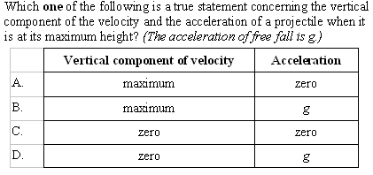
Topic 2: Mechanics 2.1 – Motion
Analysing projectile motion
∙The acceleration is ALWAYS g for projectile motion-since it is caused by Earth and its field.
∙At the maximum height the projectile switches from upward to downward motion. v_{y} = 0 at switch.
Notes:
© 2006 By Timothy K. Lund

Slide 75
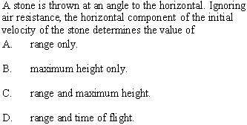
Topic 2: Mechanics 2.1 – Motion
Analysing projectile motion
∙The flight time is limited by the y motion.
∙The maximum height is limited by the y motion.
Notes:
© 2006 By Timothy K. Lund

Slide 76
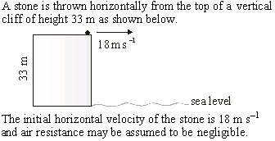

Topic 2: Mechanics 2.1 – Motion
Analysing projectile motion
a_{x} = 0.
a_{y} = -10 ms⁻².
Notes:
© 2006 By Timothy K. Lund

Slide 77

Topic 2: Mechanics 2.1 – Motion
Analysing projectile motion
∆y = u_{y}t - 5t ²
-33 = 0t - 5t ²
-33 = -5t ²
(33/5) = t ²
∙Fall time limited by y-equations:
∙t = 2.6 s.
Notes:
© 2006 By Timothy K. Lund

Slide 78
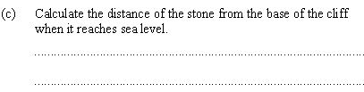
Topic 2: Mechanics 2.1 – Motion
Analysing projectile motion
∆x = u_{x}t
∆x = 18(2.6)
∙Use x-equations and t = 2.6 s:
∙∆x = 47 m.
Notes:
© 2006 By Timothy K. Lund

Slide 79

Topic 2: Mechanics 2.1 – Motion
Analysing projectile motion
18
θ
v_{y} = u_{y} – 10t
26
v_{x} = u_{x}
v_{y} = 0 – 10t
v_{x} = 18.
v_{y} = –10(2.6) = -26.
∙tan θ = 26/18
θ = tan⁻¹(26/18) = 55º.
Notes:
© 2006 By Timothy K. Lund

Slide 80
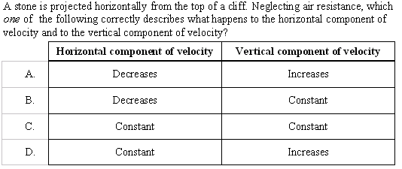
Topic 2: Mechanics 2.1 – Motion
Analysing projectile motion
∙The horizontal component of velocity is v_{x} = u_{x} which is CONSTANT.
∙The vertical component of velocity is v_{y} = u_{y} – 10t , which is INCREASING (negatively).
Notes:
© 2006 By Timothy K. Lund

Slide 81
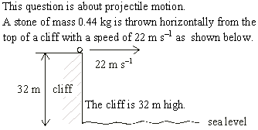
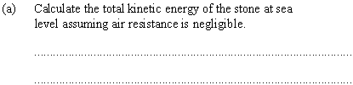
Topic 2: Mechanics 2.1 – Motion
Analysing projectile motion
∙ ∆E_{K} + ∆E_{P} = 0
∆E_{K} = -∆E_{P}
∆E_{K} = -mg∆h
E_{Ko} = (1/2)mu²
∆E_{K} = -(0.44)(9.8)(-32) = ⁺138 J = E_{K} – E_{Ko}
E_{K} = ⁺138 + (1/2)(0.44)(22²) = 240 J.
Notes:
© 2006 By Timothy K. Lund

Slide 82
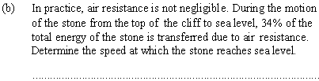
Topic 2: Mechanics 2.1 – Motion
Analysing projectile motion
∙If 34% of the energy is consumed, 76% remains.
0.76(240) = 180 J
(1/2)(0.44)v² = 180 J
∙v = 29 ms⁻¹.
Notes:
© 2006 By Timothy K. Lund

Slide 83
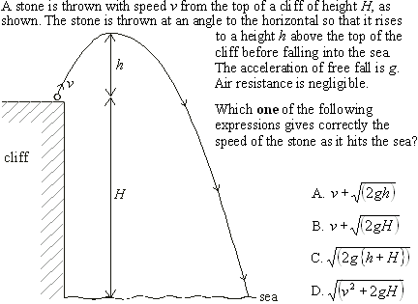
Topic 2: Mechanics 2.1 – Motion
(1/2)mv_{f}² - (1/2)mv² = -∆E_{P}
mv_{f}² = mv² + -2mg(0-H)
v_{f}² = v² + 2gH
Analysing projectile motion
∙Use ∆E_{K} + ∆E_{P} = 0.
Notes:
© 2006 By Timothy K. Lund

Slide 84
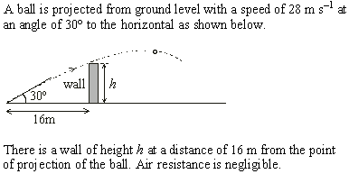
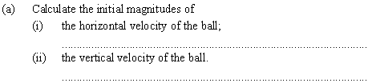
Topic 2: Mechanics 2.1 – Motion
Analysing projectile motion
u_{y} = u sin θ
u_{y} = 28 sin 30º
u_{x} = u cos θ
u_{x} = 28 cos 30º
u_{x} = 24 m s⁻¹.
u_{y} = 14 m s⁻¹.
Notes:
© 2006 By Timothy K. Lund

Slide 85

Topic 2: Mechanics 2.1 – Motion
Analysing projectile motion
∆x = u_{x}t
16 = 24t
t = 16 / 24 = 0.67
∙The time to the wall is found from ∆x…
∆y = u_{y}t – 5t ²
∆y = 14t – 5t ²
∆y = 14(0.67) – 5(0.67)² = 7.1 m.
Notes:
© 2006 By Timothy K. Lund

Slide 86
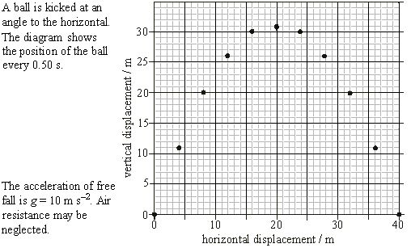

Topic 2: Mechanics 2.1 – Motion
Analysing projectile motion
0.5s
0.0s
4 m
u_{x} = ∆x / ∆t = (4 - 0) / (0.5 - 0.0) = 8 ms⁻¹.
Notes:
© 2006 By Timothy K. Lund

Slide 87

Topic 2: Mechanics 2.1 – Motion
Analysing projectile motion
0.5s
11 m
0.0s
4 m
u_{y} = ∆y / ∆t = (11 - 0) / (0.5 - 0.0) = 22 ms⁻¹.
Notes:
© 2006 By Timothy K. Lund

Slide 88

Topic 2: Mechanics 2.1 – Motion
Analysing projectile motion
2.0
2.5
3.0
1.5
1.0
D
30 m
0.5s
11 m
0.0s
θ
θ = tan⁻¹(30/24) = 51º
4 m
24 m
,@ θ = 51º.
D² = 24² + 30² so that D = 38 m
Notes:
© 2006 By Timothy K. Lund

Slide 89

Topic 2: Mechanics 2.1 – Motion
Analysing projectile motion
∙New peak below and left.
∙Pre-peak greater than post-peak.
Notes:
© 2006 By Timothy K. Lund

